Slide 1
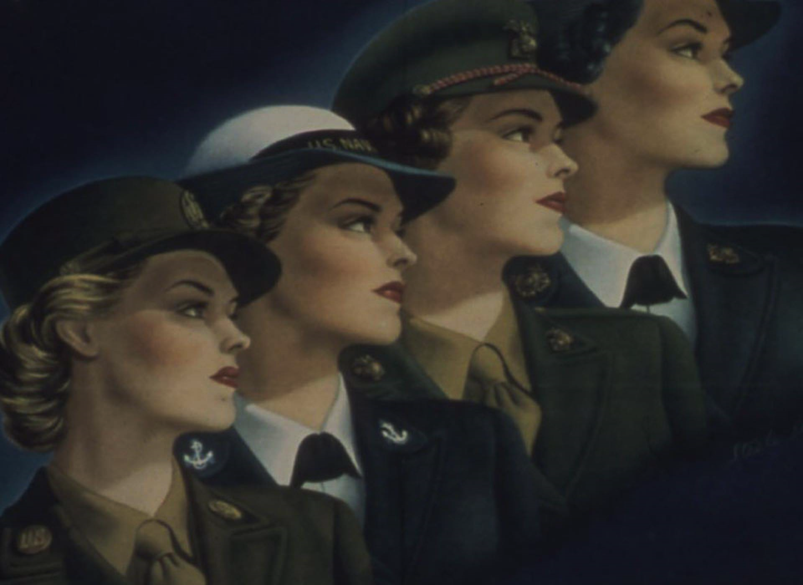



2ο ΕΠΑΛ ΡΕΘΥΜΝΟΥ
Project Code:
2024-1-el01-ka122-sch-000231856
Women's Role in WW2
« Με την επιχορήγηση της ΕυρωπαΪκής Ένωσης, Ωστόσο, οι απόψεις και οι γνώμεις που διατυπώνονται εκφράζουν αποκλειστικά τις απόψεις των συντάκτων και δεν αντιπροσωπεύονται κατ' ανάγκη τις απόψεις της Ευρωπαϊκής Ένωσης ή του Ιδρύματος Κρατικών Υποτροφιών (ΙΚΥ), Ούτε η Ευρωπαϊκή Ένωση ούτε η χορηγούσα αρχή μπορούν να θεωρηθούν υπεύθηνες για αυτές.»

Slide 2
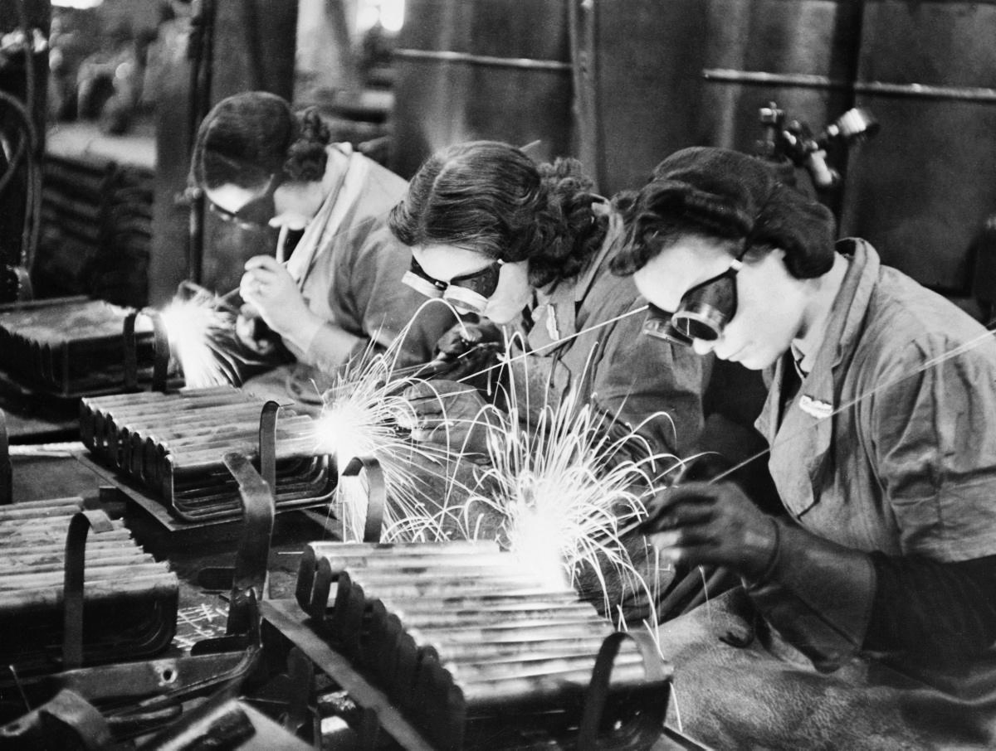
INTRODUCTION
During World War II, women’s roles changed dramatically.
With millions of men fighting on the front lines, women stepped into jobs, responsibilities, and positions that had previously been reserved for men.
Their contribution was crucial to the war effort and reshaped social attitudes toward gender roles.

Slide 3
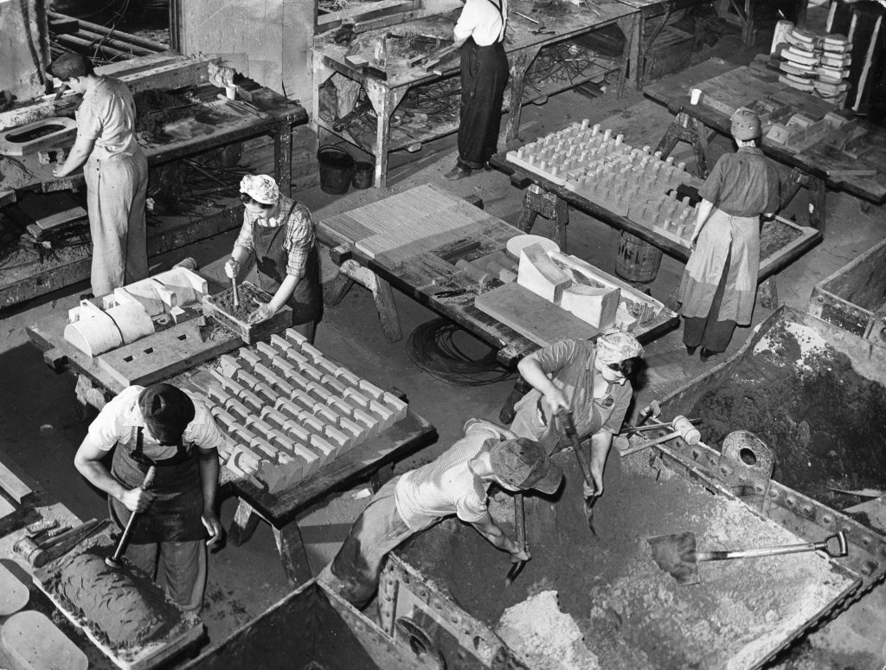
WOMEN AT WORK
Women filled industrial and agricultural jobs that men had left behind when they joined the military.
They worked in munitions factories, producing weapons and ammunition, as well as in transportation, shipbuilding, and farming.

Slide 4
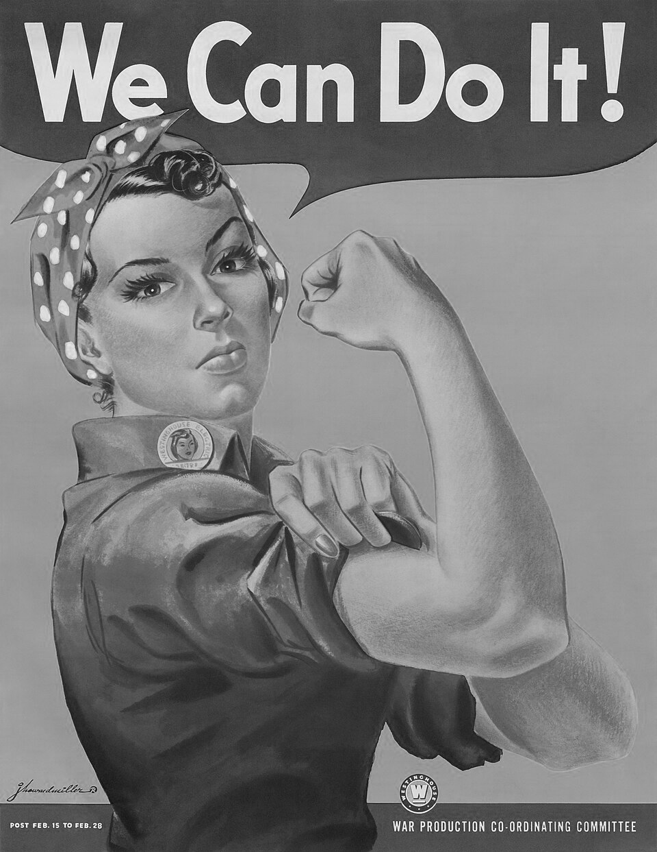
In the United States, the symbol “Rosie the Riveter” represented the millions of women who joined the workforce and proved their strength and skill.
In Britain, the Women’s Land Army recruited women to keep food production running while the men were away.
In the Soviet Union, women not only maintained industrial output but also learned to operate heavy machinery and sometimes joined combat units directly.

Slide 5
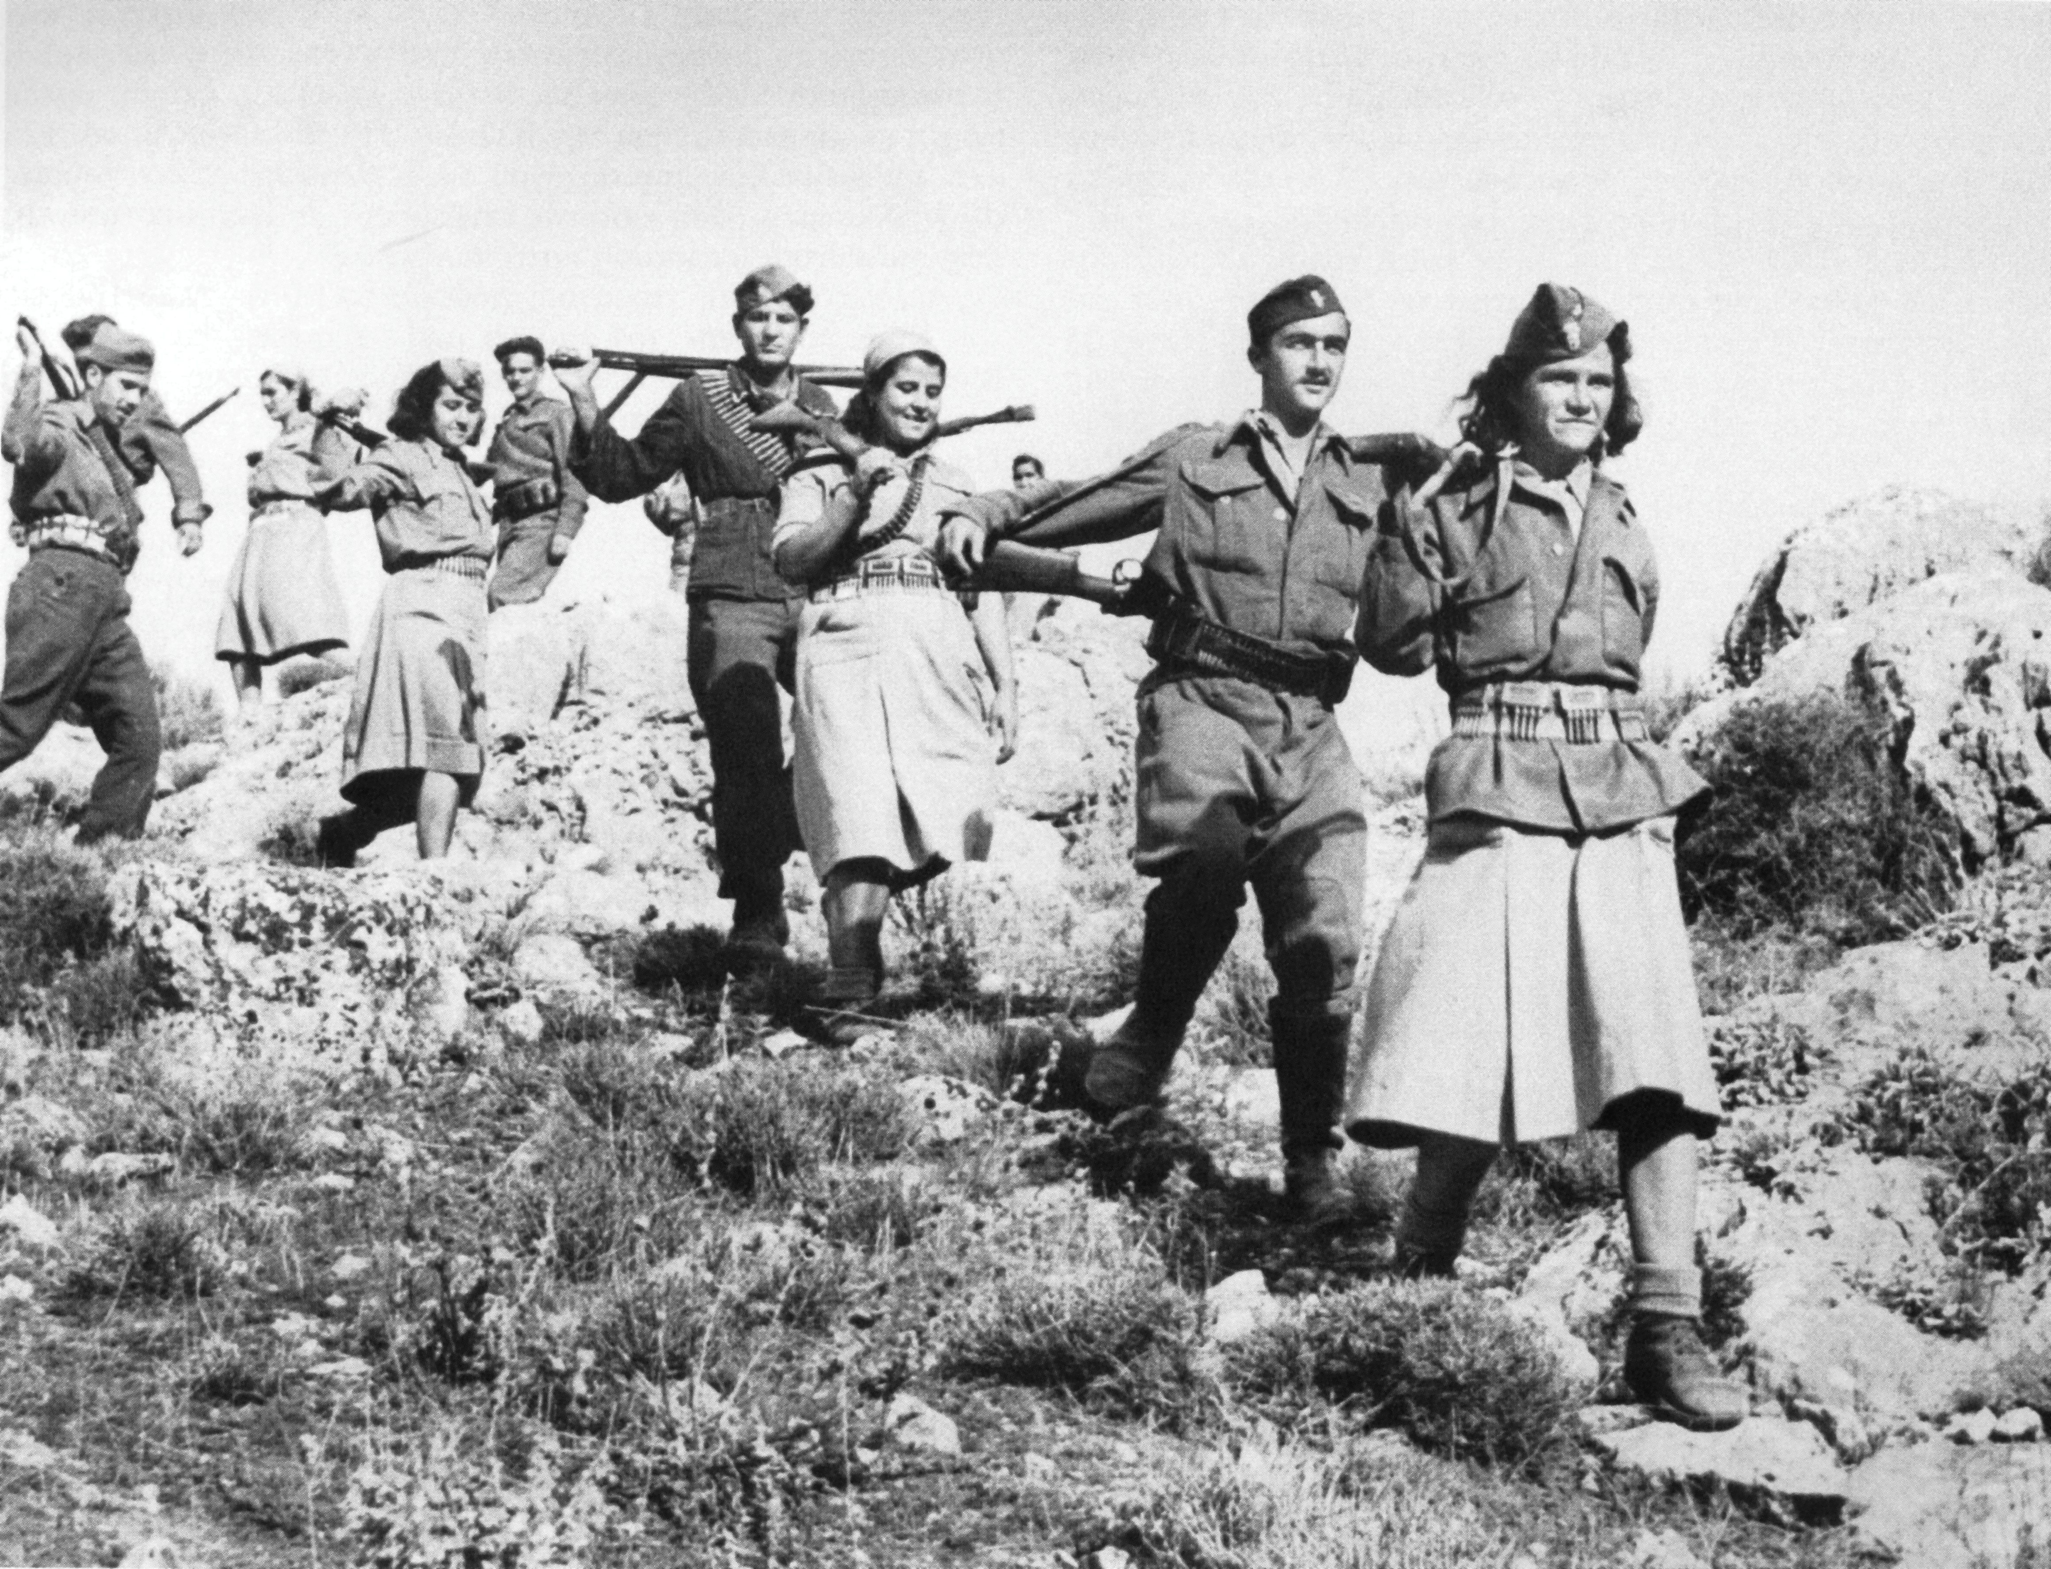
Military and Resistance Involvement
In the Soviet Union, thousands of women served as snipers, pilots, medics, and partisans in the Red Army.
Lyudmila Pavlichenko, one of history’s top snipers, became a symbol of women in combat.
In the U.S. and U.K., women joined auxiliary corps like the WAC, WAAF, and ATS, handling communication, intelligence, and logistics to support front-line troops.
In Greece, women joined the Resistance, serving as couriers, nurses, and fighters in groups like EAM-ELAS.

Slide 6
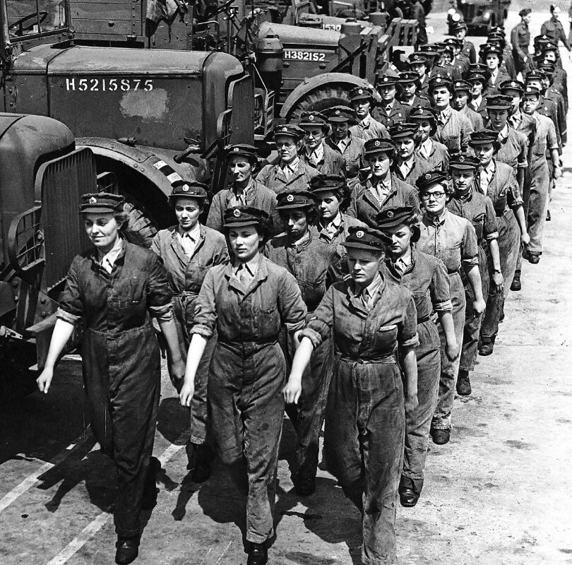
Back home, women managed households, children, and entire communities under severe wartime conditions.
They faced shortages of food and materials, bombings, and the constant fear of loss, yet kept daily life functioning as best as possible.
Their ability to adapt and take responsibility gave them new confidence and independence that carried beyond the war years.
However, when men returned from the front, many societies expected women to go back to traditional domestic roles, creating tension between old norms and new realities.
Life on the Home Front

Slide 7
Impact and Legacy
The war permanently changed how the world viewed women’s abilities and place in society. Their success in industry, the military, and resistance movements proved that they could handle work and responsibility equal to men. This experience laid the foundation for the post-war women’s rights movements and the broader fight for gender equality. World War II didn’t just change geopolitics — it redefined what it meant to be a woman in the modern world.

Slide 8
2ο ΕΠΑΛ ΡΕΘΥΜΝΟΥ
Project Code:
2024-1-el01-ka122-sch-000231856
« Με την επιχορήγηση της ΕυρωπαΪκής Ένωσης, Ωστόσο, οι απόψεις και οι γνώμεις που διατυπώνονται εκφράζουν αποκλειστικά τις απόψεις των συντάκτων και δεν αντιπροσωπεύονται κατ' ανάγκη τις απόψεις της Ευρωπαϊκής Ένωσης ή του Ιδρύματος Κρατικών Υποτροφιών (ΙΚΥ), Ούτε η Ευρωπαϊκή Ένωση ούτε η χορηγούσα αρχή μπορούν να θεωρηθούν υπεύθηνες για αυτές.»

Slide 9
Sources
United States Holocaust Memorial Museum – World War II and the Holocaust
https://www.ushmm.org/learn/holocaust-and-world-war-ii/world-war-ii-and-the-holocaust
Imperial War Museums (UK) – The Vital Role of Women in the Second World War
https://www.iwm.org.uk/history/the-vital-role-of-women-in-the-second-world-war
Encyclopedia Britannica – Women’s Army Corps (WAC)
https://www.britannica.com/topic/Womens-Army-Corps
The National WWII Museum (USA) – Women of World War II
https://www.nationalww2museum.org/war/topics/women-world-war-ii

