Slide 1



2ο ΕΠΑΛ ΡΕΘΥΜΝΟΥ​
Project Code:​
2024-1-el01-ka122-sch-000231856​
« Με την επιχορήγηση της ΕυρωπαΪκής Ένωσης, Ωστόσο, οι απόψεις και οι γνώμεις που διατυπώνονται εκφράζουν αποκλειστικά τις απόψεις τωνσυντάκτων και δεν αντιπροσωπεύονται κατ' ανάγκη τις απόψεις της Ευρωπαϊκής Ένωσης ή του Ιδρύματος Κρατικών Υποτροφιών (ΙΚΥ), Ούτε ηΕυρωπαϊκή Ένωση ούτε η χορηγούσα αρχή μπορούν να θεωρηθούν υπεύθηνες για αυτές.» ​

Slide 2
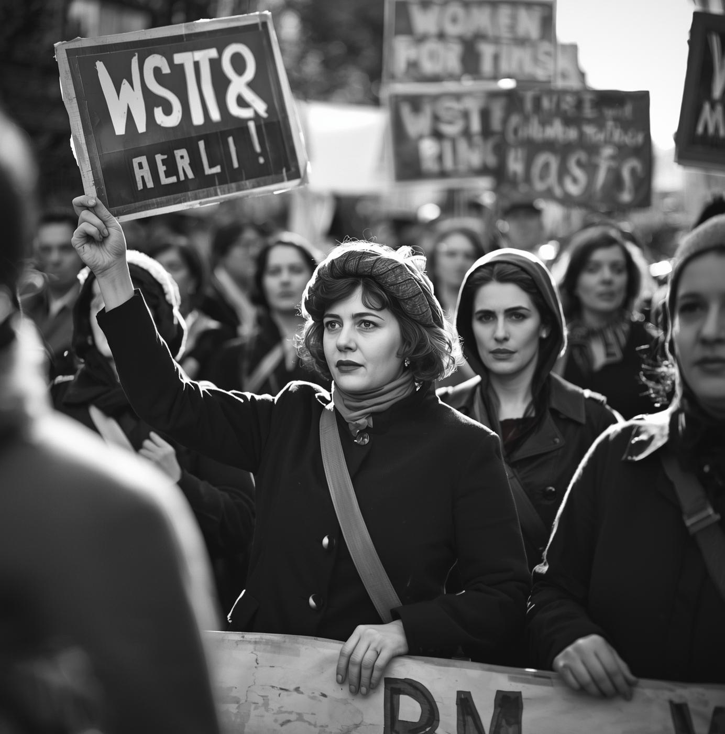
The Suffragettes — Fighting for Women’s Rights: A Presentation on Courage, Equality, and Change
Presented by: Monika, Advocate for Gender Equality and Social Justice

Slide 3
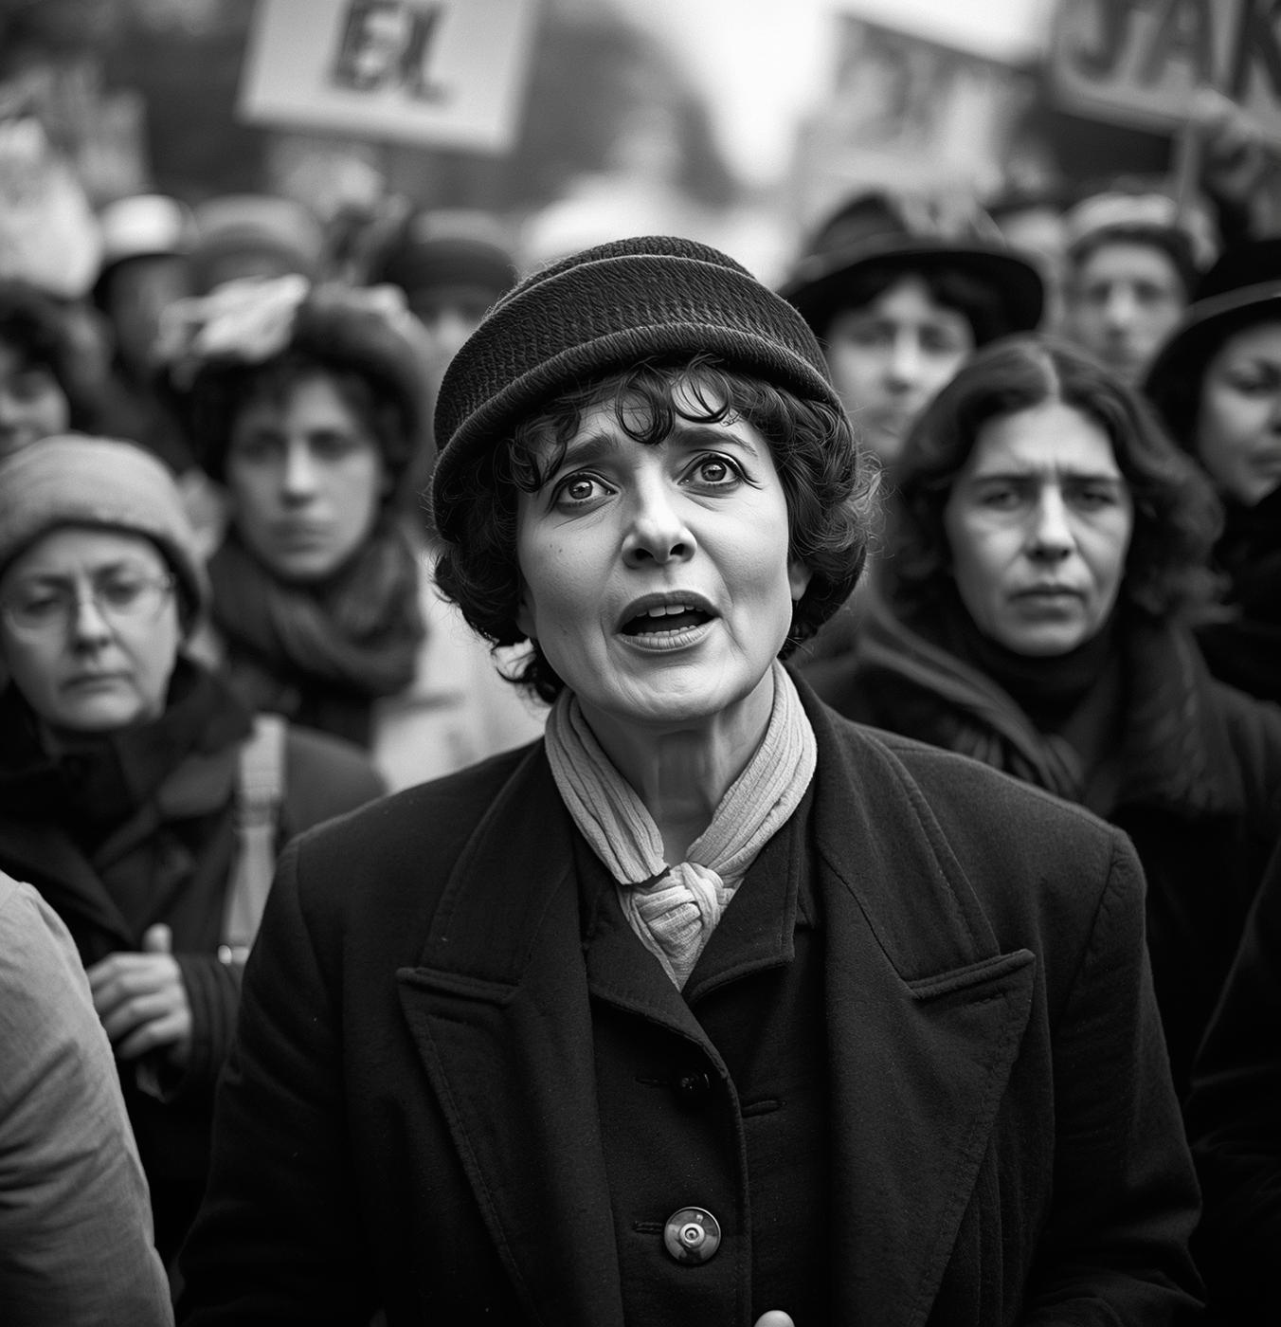
Who Were the Suffragettes?
•The suffragettes were brave women who fought for the right to vote in the early 20th century.
•They believed that women deserved the same political rights as men. The movement started in the United Kingdom and inspired women all over the world.

Slide 4
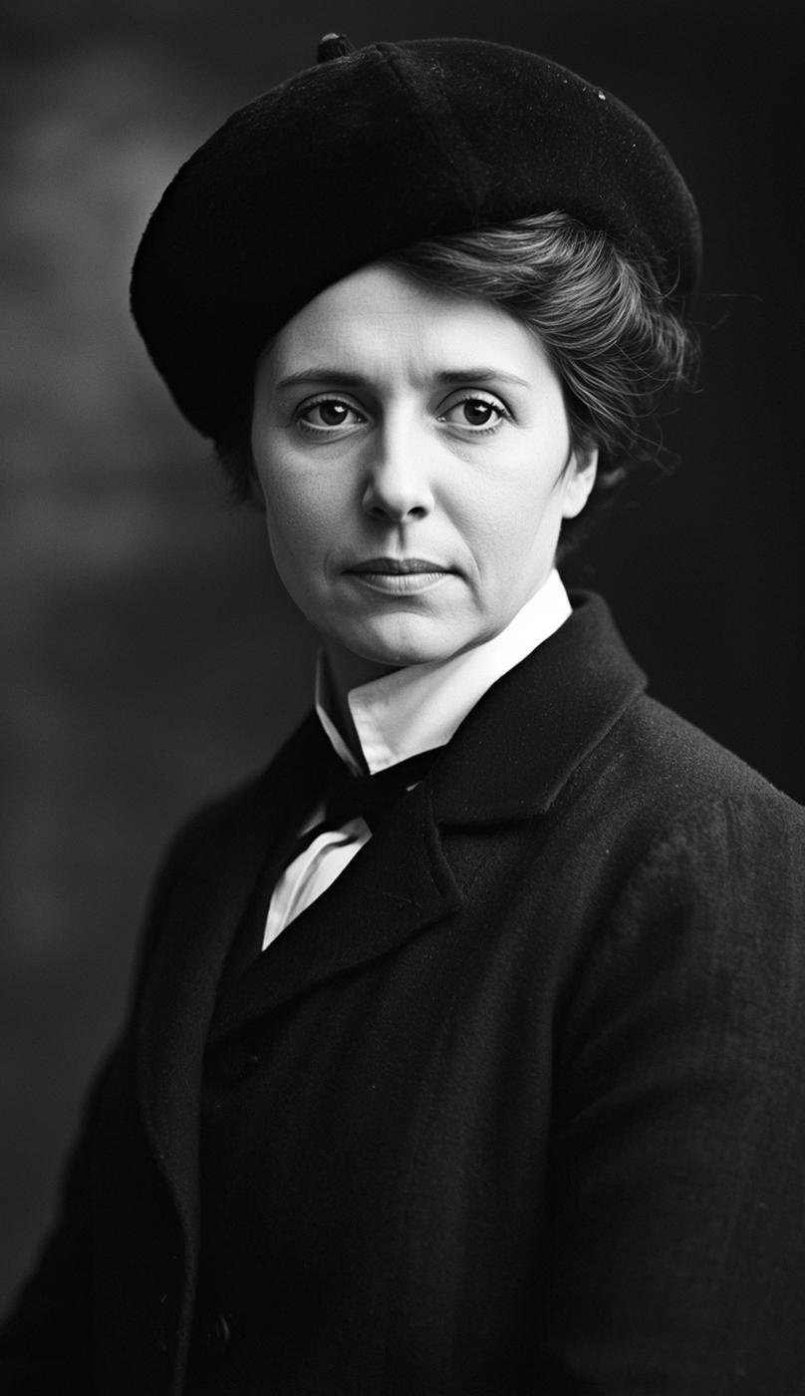

Leaders and Actions
The most famous leader was Emmeline Pankhurst, who founded the Women’s Social and Political Union (WSPU) in 1903.
•Their motto was 'Deeds, not words.' They organized protests, marches, and even went to prison for their cause.

Slide 5
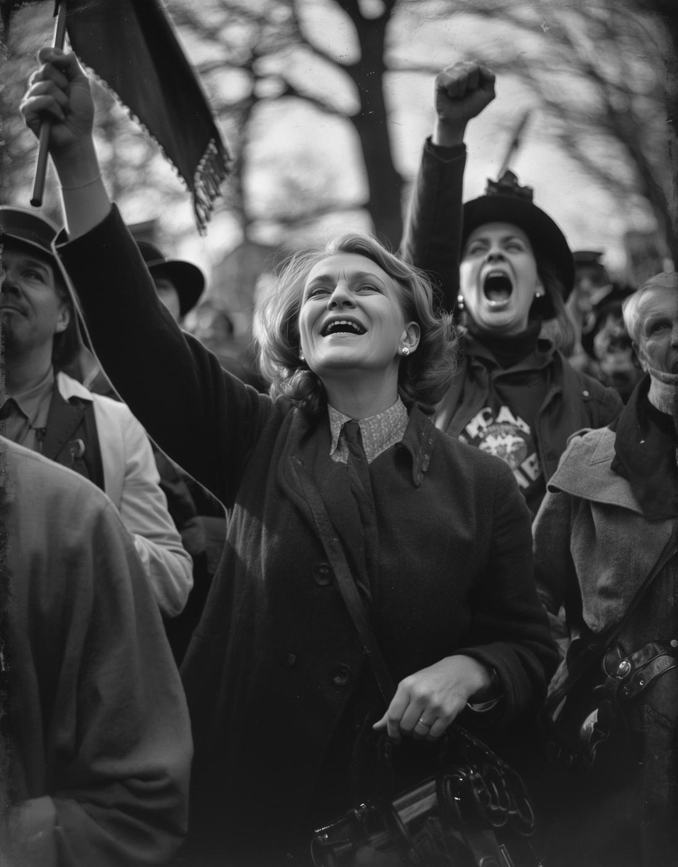
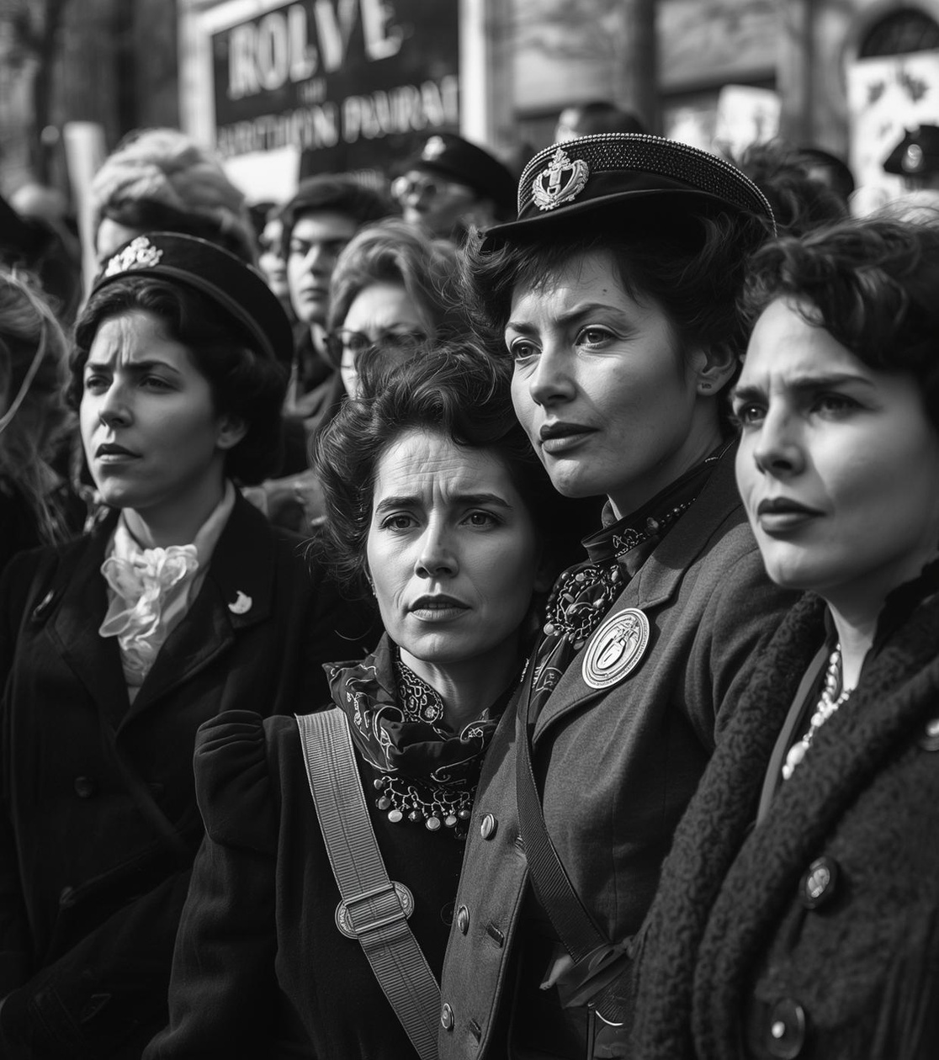
Achievements
•Because of their courage and activism, British women won the right to vote:
•• In 1918 – women over 30 could vote.
•• In 1928 – women gained equal voting rights with men.
•Their struggle inspired women in many countries, including the United States and Europe.

Slide 6
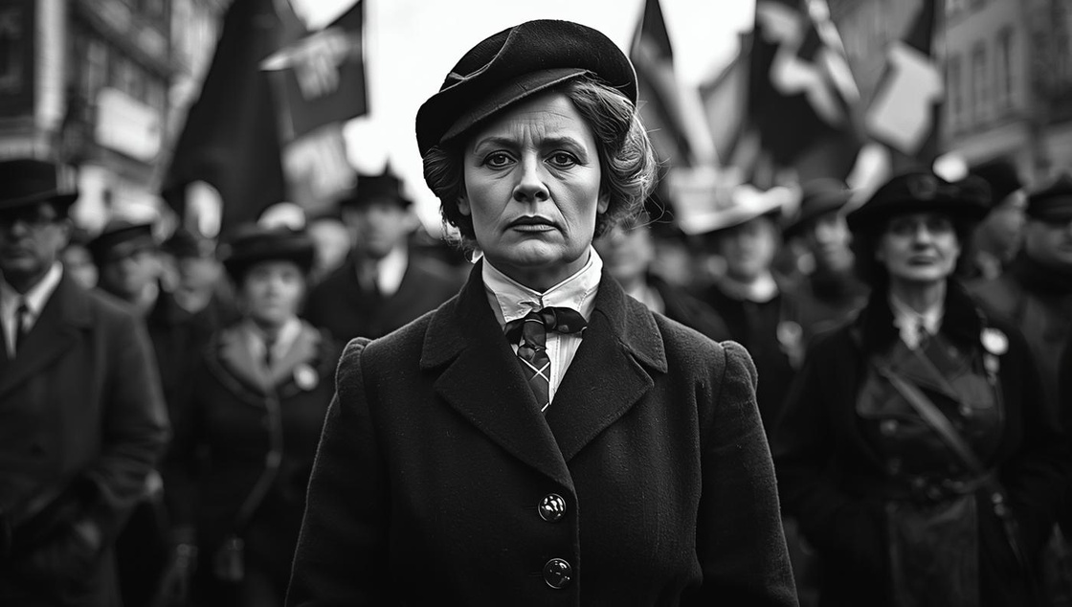
Their Difficulties and Challenges
The Suffragettes faced many challenges. They were often arrested, imprisoned, and treated badly by the police. Many went on hunger strikes in prison and were force-fed. Society and newspapers sometimes called them violent or unfeminine. Despite this, they stayed strong and continued their fight.

Slide 7
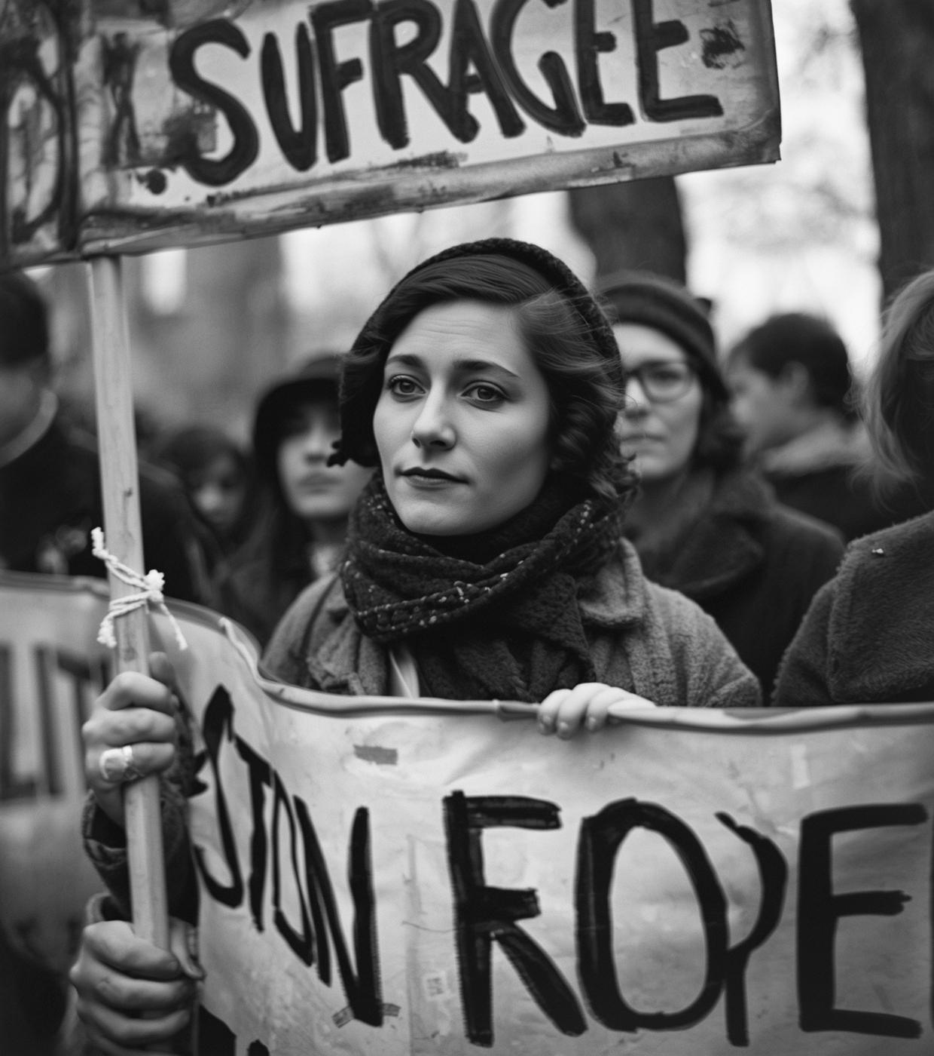
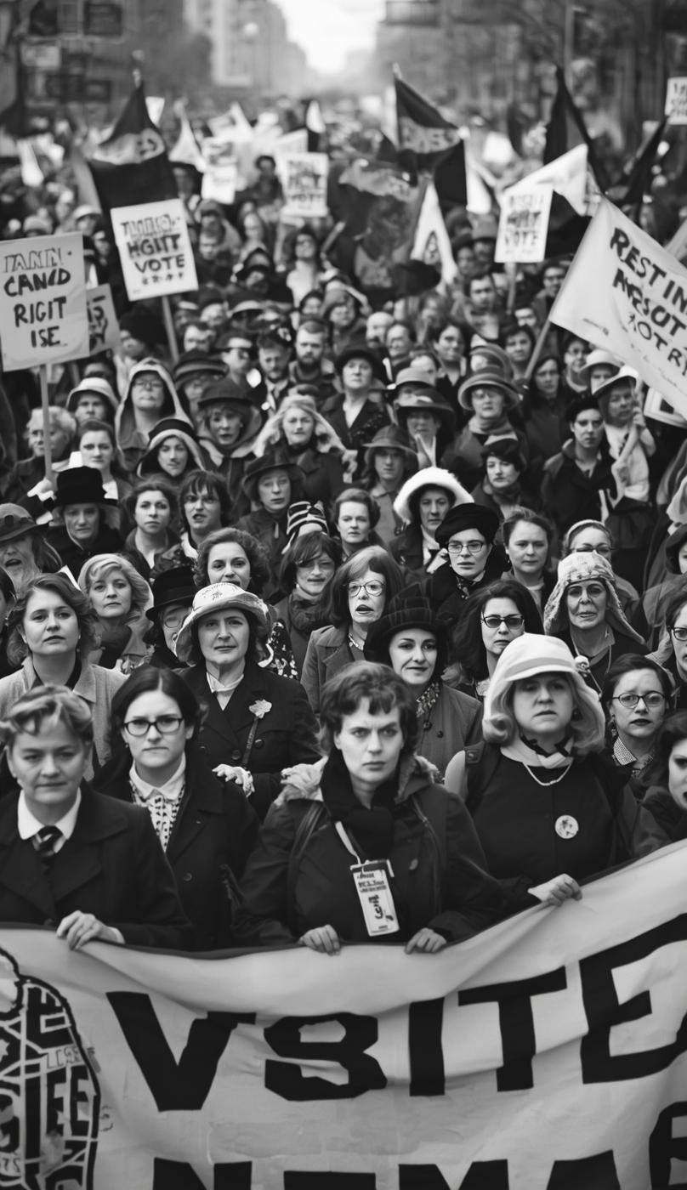
Legacy and Inspiration
•The suffragettes showed that ordinary people can change history.
•Today, women around the world continue to fight for equality in education, work, and politics.
•Their legacy reminds us to always stand up for fairness and respect.

Slide 8
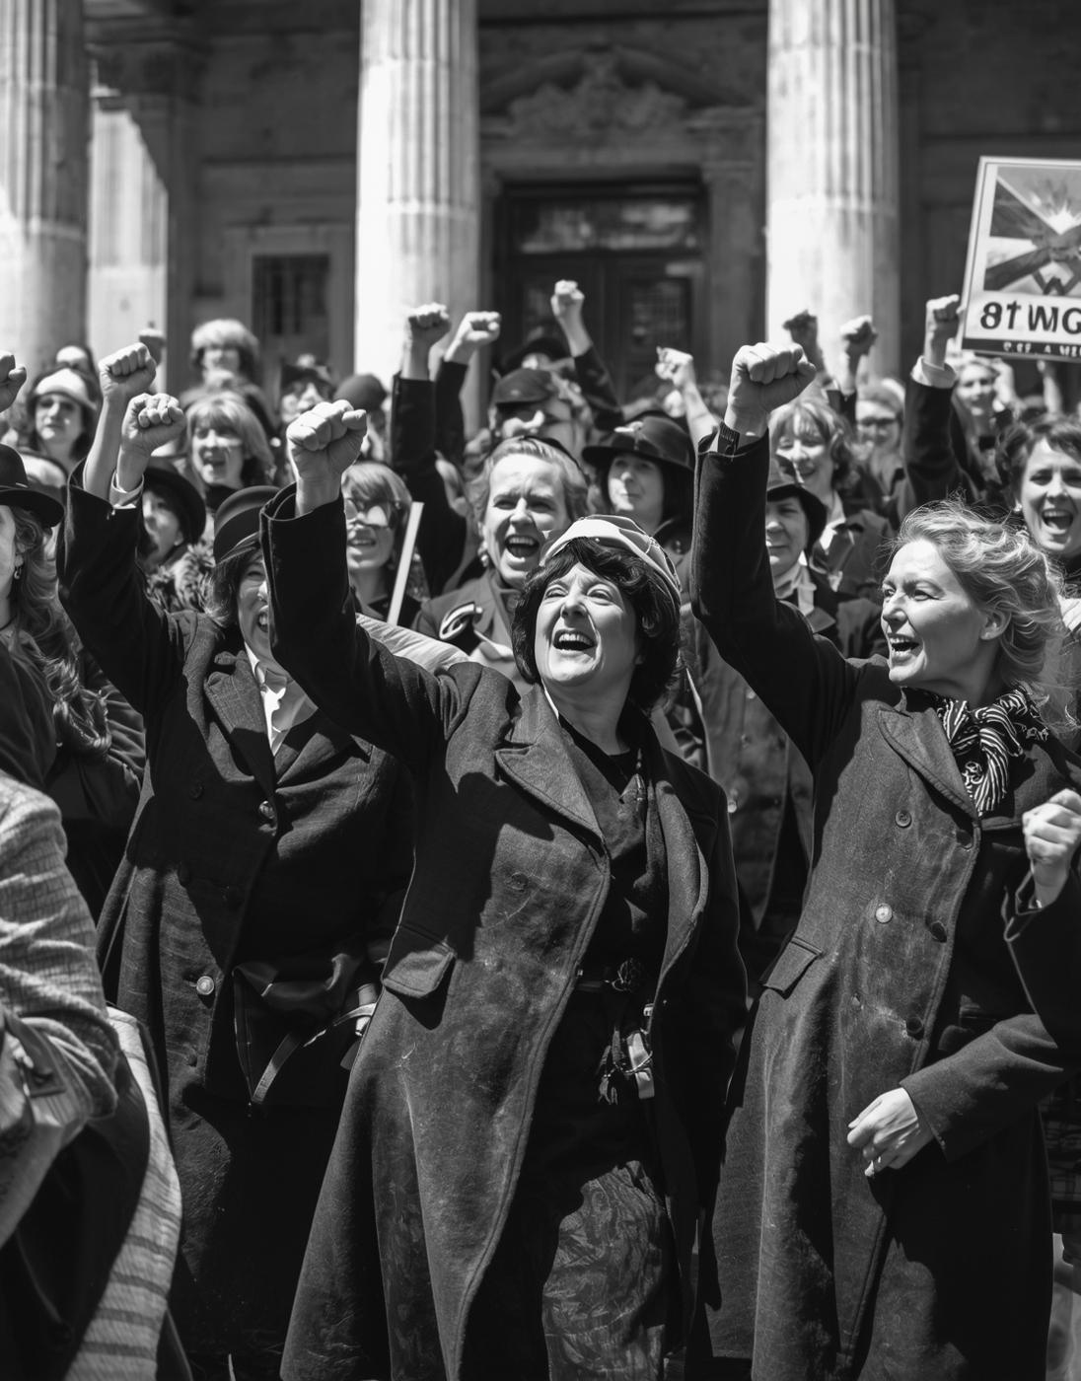
CONCLUSION
The Suffragettes were not just fighting for the vote — they were fighting for freedom, equality, and respect.
Their courage changed history and opened the doors for women everywhere.
Today, their voices still lives on, reminding us that one small act of bravery can change the world.

Slide 9
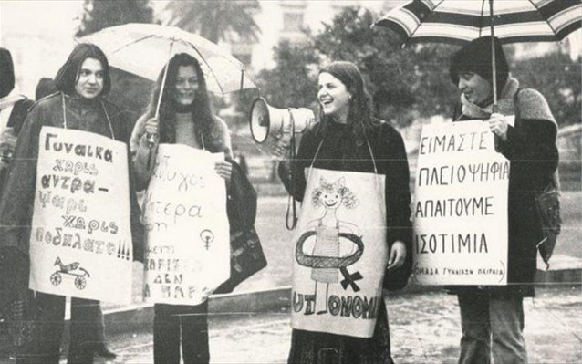
In older times Greek women had very limited rights. They could not vote, had few legal and economic freedoms, and were expected to focus on family life. They gained the right to vote in local elections in 1930 and full political rights in 1952, with gradual legal equality coming after the 1970s.
Greek women

Slide 10
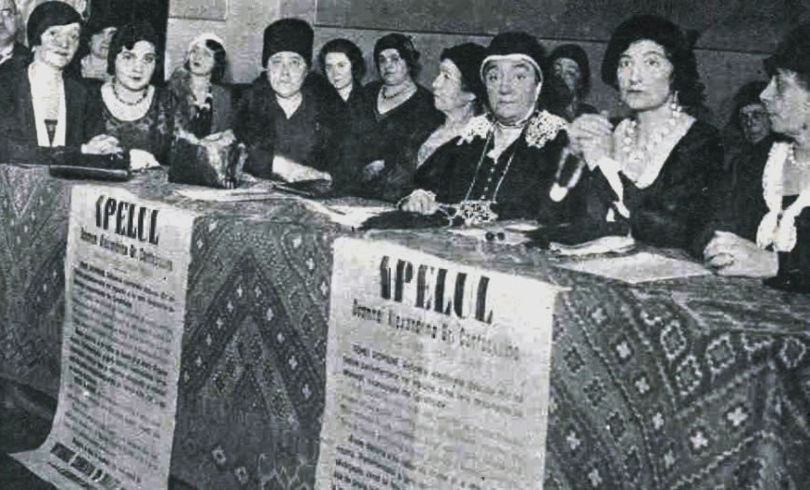
ROMANIAN WOMEN
Romanian women also had restricted rights in the past, with limited access to education, property, and politics. Some women gained local voting rights in 1929 and first vote d in 1930. Full political. equality was granted after World War II, especially from 1946–1948.

Slide 11
In older times Greek women had very limited rights. They could not vote, had few legal and economic freedoms, and were expected to focus on family life. They gained the right to vote in local elections in 1930 and full political rights in 1952, with gradual legal equality coming after the 1970s.
Greek women

Slide 12
2ο ΕΠΑΛ ΡΕΘΥΜΝΟΥ​
Project Code:​
2024-1-el01-ka122-sch-000231856​
« Με την επιχορήγηση της ΕυρωπαΪκής Ένωσης, Ωστόσο, οι απόψεις και οι γνώμεις που διατυπώνονται εκφράζουν αποκλειστικά τις απόψεις τωνσυντάκτων και δεν αντιπροσωπεύονται κατ' ανάγκη τις απόψεις της Ευρωπαϊκής Ένωσης ή του Ιδρύματος Κρατικών Υποτροφιών (ΙΚΥ), Ούτε ηΕυρωπαϊκή Ένωση ούτε η χορηγούσα αρχή μπορούν να θεωρηθούν υπεύθηνες για αυτές.» ​

Slide 13
link

Slide 14
Links
headinghttps://www.londonmuseum.org.uk/collections/london-stories/the-suffragettes/
headinghttps://www.nationalarchives.gov.uk/help-with-your-research/research-guides/womens-suffrage/
headinghttps://www.bbc.co.uk/bitesize/articles/zh6nsk7

