Slide 1
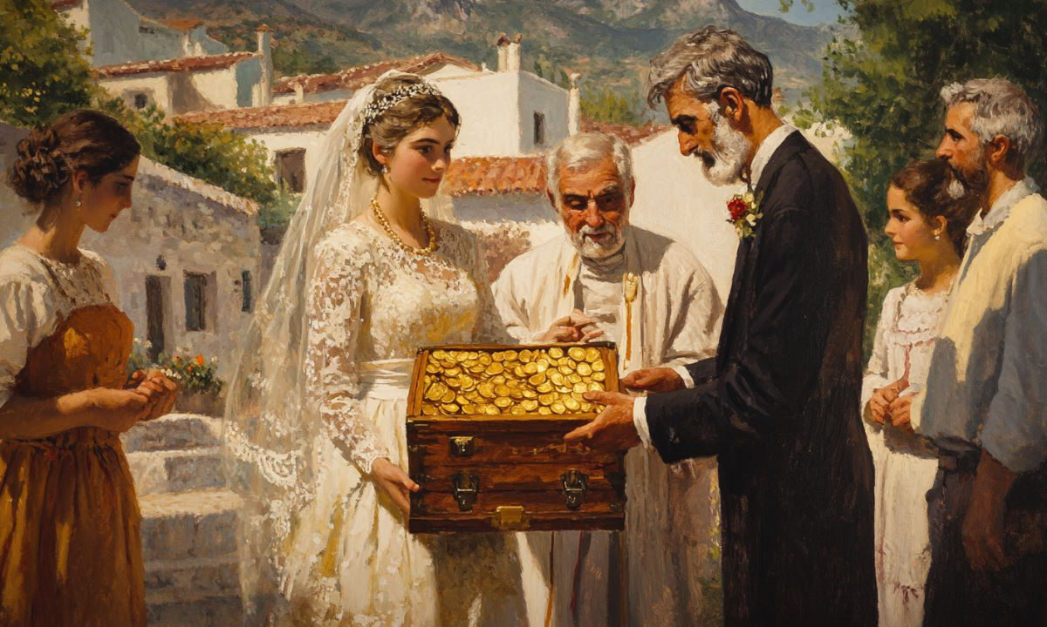



2ο ΕΠΑΛ ΡΕΘΥΜΝΟΥ
Project Code:
2024-1-el01-ka122-sch-000231856
THE CUSTOM OF
DOWRY
THE CUSTOM OF DOWRY IN GREECE IN DIFFERENT PERIODS: WHAT IMPACT IT HAD ON WOMEN'S LIVES AND HOW IT STAMBLED THEM.
ΗΙΓΓΓΙΘΚΙΘΠ
« Με την επιχορήγηση της ΕυρωπαΪκής Ένωσης, Ωστόσο, οι απόψεις και οι γνώμεις που διατυπώνονται εκφράζουν αποκλειστικά τις απόψεις των συντάκτων και δεν αντιπροσωπεύονται κατ' ανάγκη τις απόψεις της Ευρωπαϊκής Ένωσης ή του Ιδρύματος Κρατικών Υποτροφιών (ΙΚΥ), Ούτε η Ευρωπαϊκή Ένωση ούτε η χορηγούσα αρχή μπορούν να θεωρηθούν υπεύθηνες για αυτές.»

Slide 2
WHAT IS
THE CUSTOM OF
DOWRY?
ΗΙΓΓΓΙΘΚΙΘΠ
DOWRY IS AN INSTITUTION IN WHICH THE FAMILY GIVES TO THE BRIDE PART OF THEIR PROPERTY WHEN SHE MARRIES. THE INSTITUTION OF DOWRY HAS EXISTED SINCE ANCIENT TIMES AND WAS THE WOMAN'S CONTRIBUTION TO THE COUPLE'S LIFE TOGETHER.

Slide 3
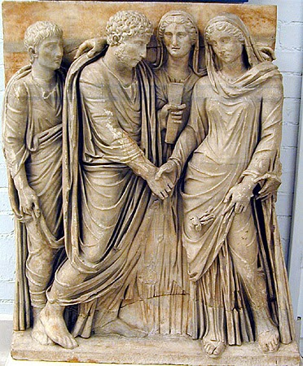
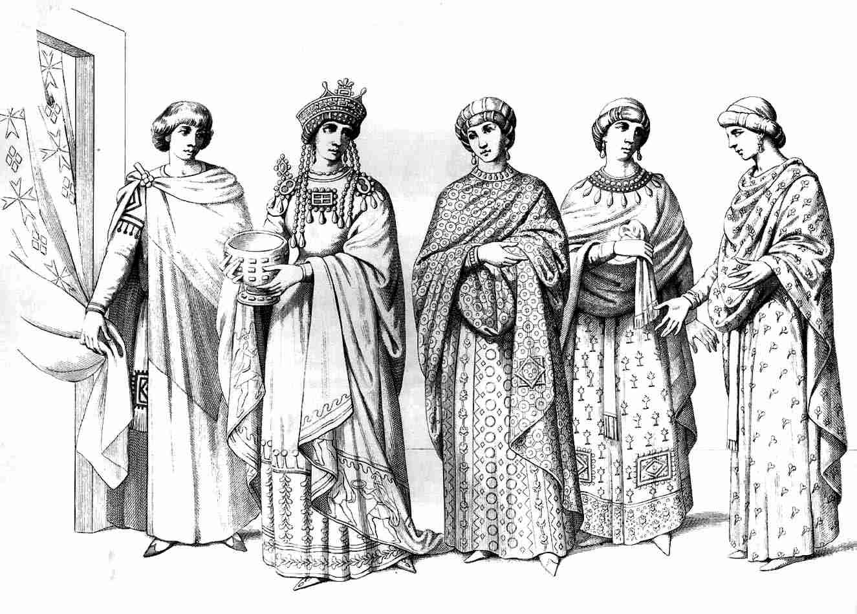
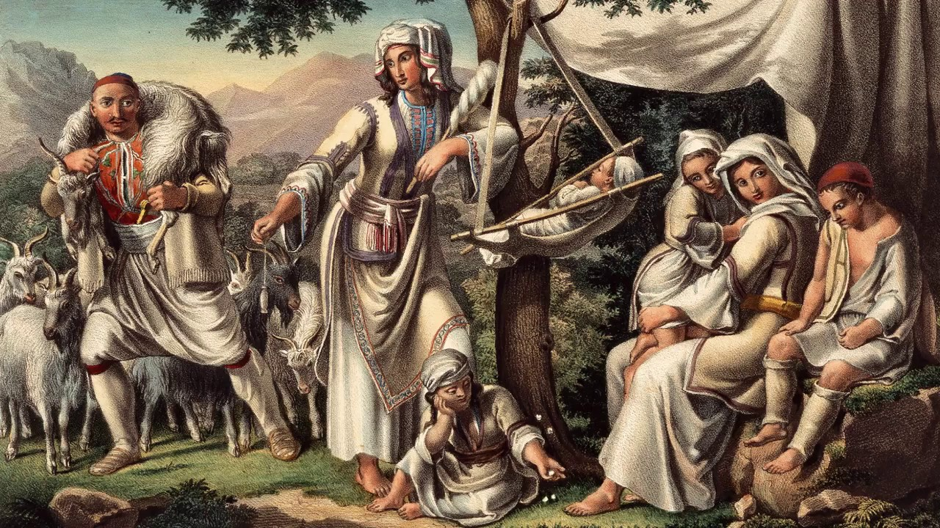
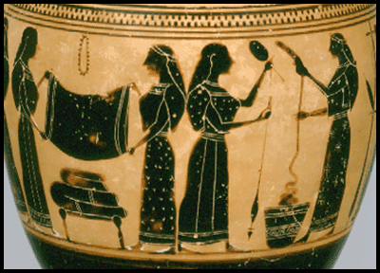
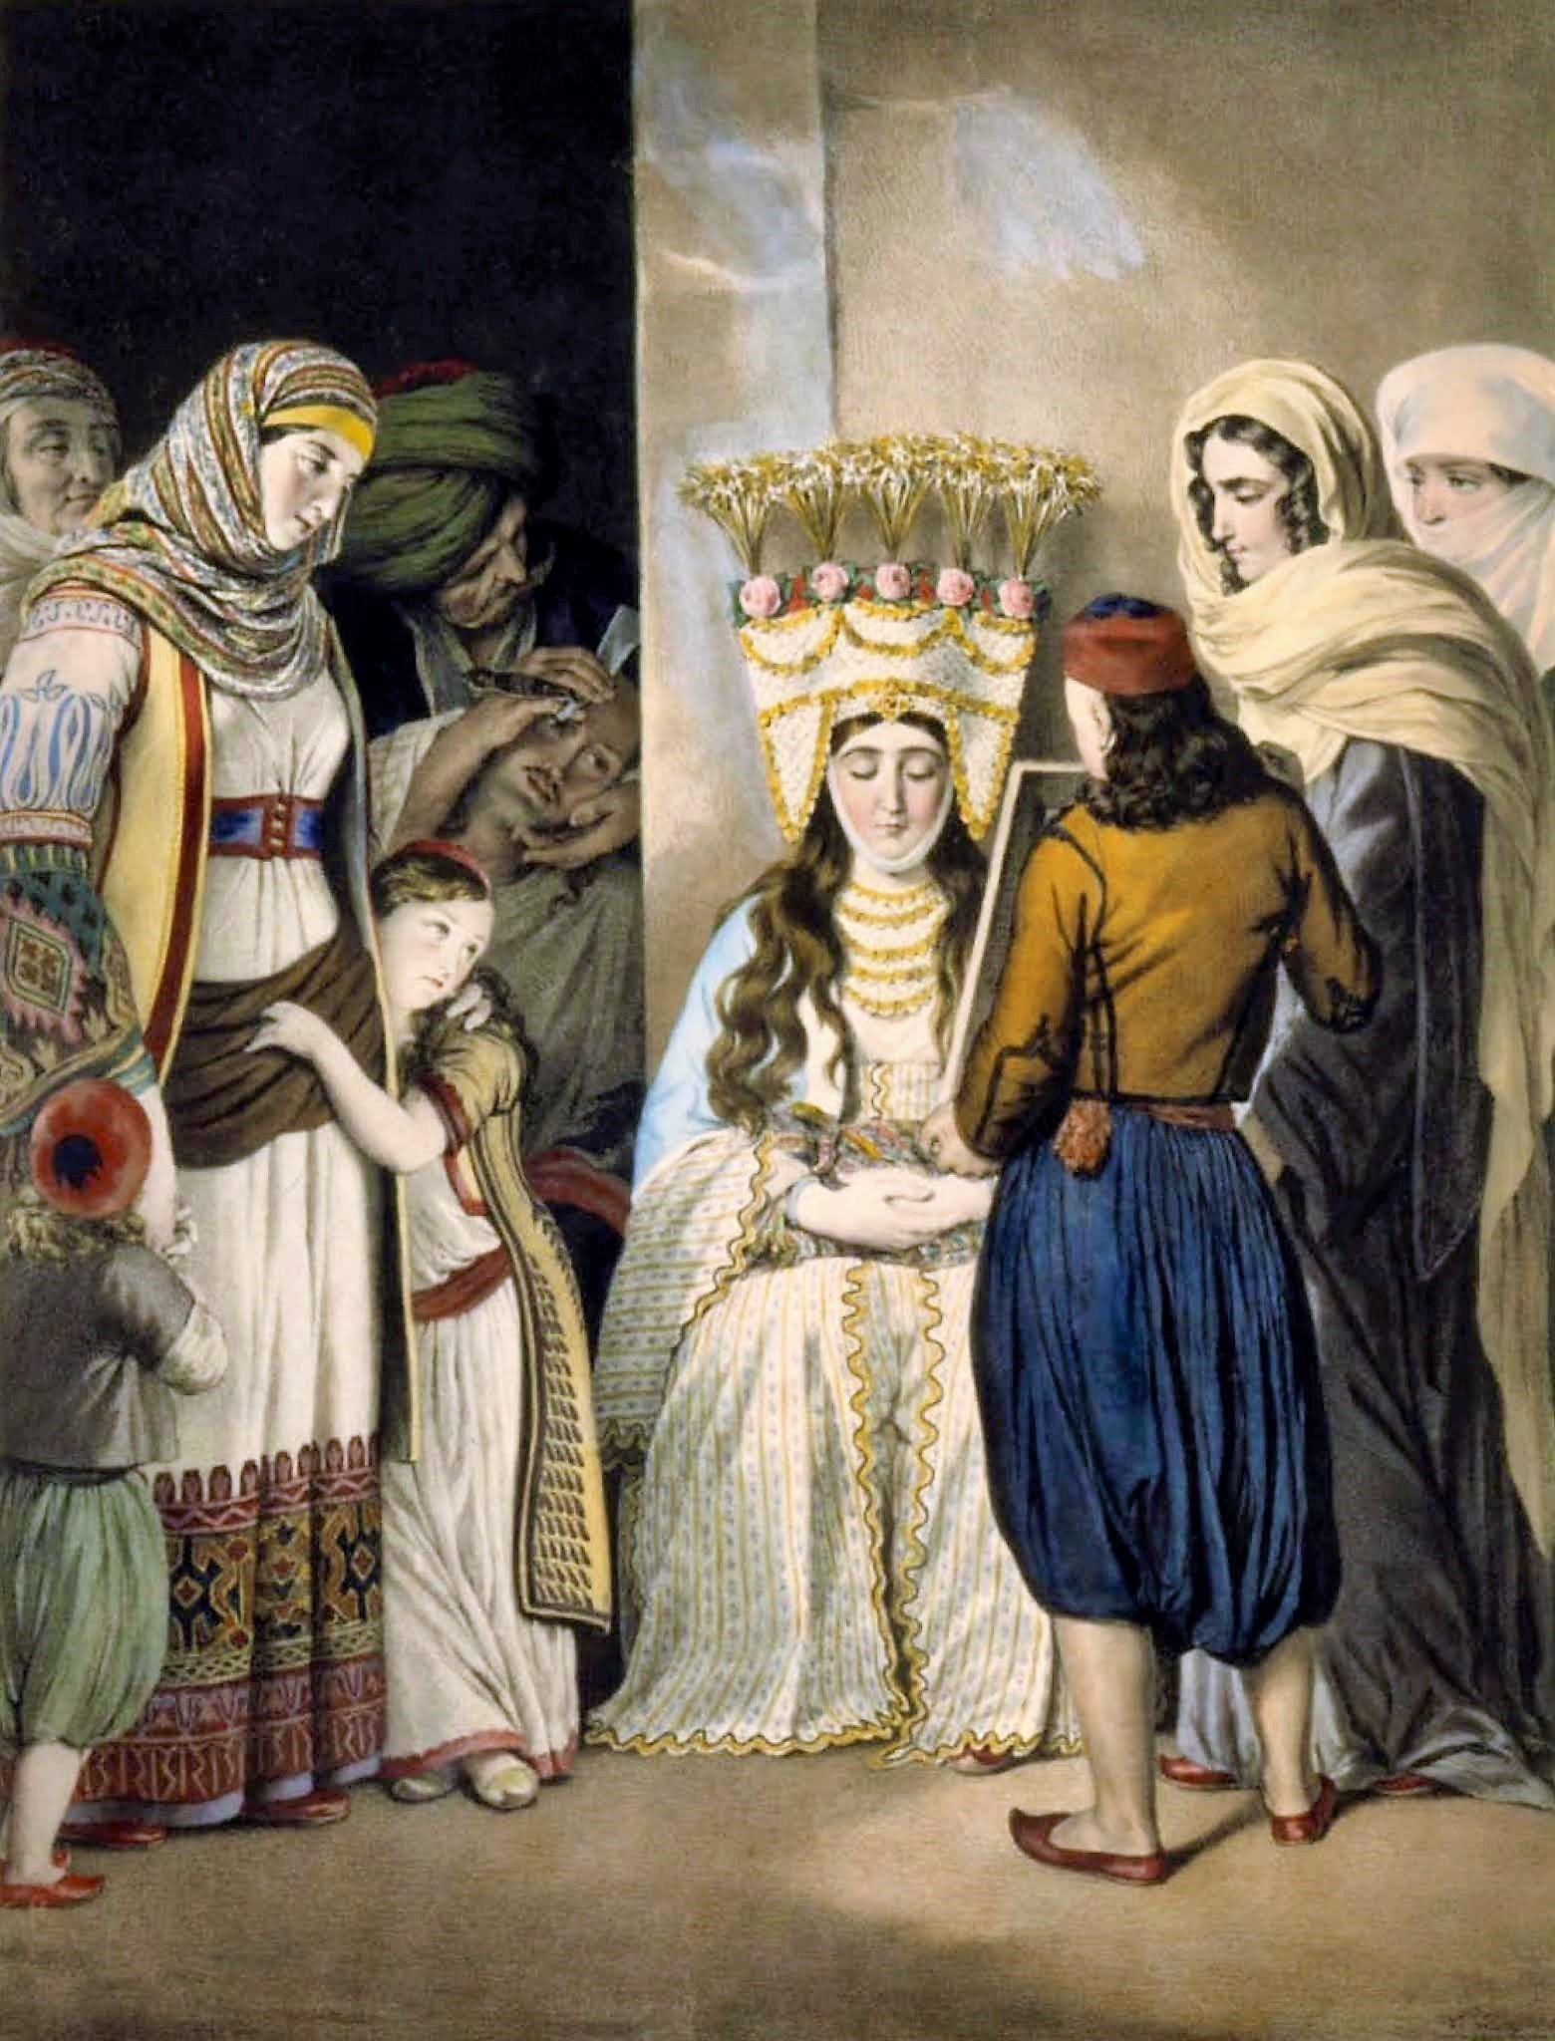
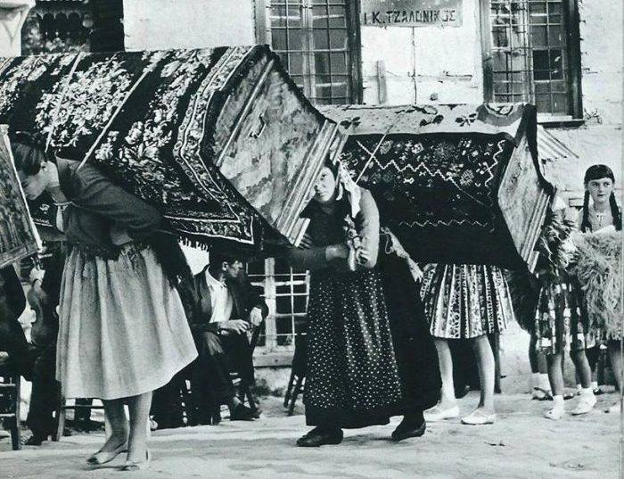
THE CUSTOM OF
DOWRY
IN DIFFERENT TIMES
ΗΙΓΓΓΙΘΚΙΘΠ
ThePhoto by PhotoAuthor is licensed under CCYYSA.

Slide 4
THE CUSTOM OF
DOWRY
IN DIFFERENT TIMES
ΗΙΓΓΓΙΘΚΙΘΠ
ThePhoto by PhotoAuthor is licensed under CCYYSA.

Slide 5
THE CUSTOM OF
1100 - 750 B.C.
DOWRY
IN HOMERIC ERA
ΗΙΓΓΓΙΘΚΙΘΠ
IN THE HOMERIC ERA, MARRIAGES BETWEEN NOBLES WERE MADE EITHER BY BUYING THE BRIDE, OR BY CONTESTS BETWEEN NOBLES WITH THE BRIDE AS A PRIZE, OR BY KIDNAPPING WOMEN. HOMER REFERS TO THE DOWRY AS "THE SHARE GIVEN TO MARRIAGES, PROIX OR FERNE".
ThePhoto by PhotoAuthor is licensed under CCYYSA.

Slide 6
THE CUSTOM OF
8TH – 6TH CENTURY B.C.
DOWRY
IN ANTIQUITY
IN ANTIQUITY, A DOWRY WAS THE PROPERTY OR MONEY A BRIDE'S FAMILY GAVE TO THE GROOM OR HIS FAMILY AT MARRIAGE. IT WAS FUNCTIONED AS FINANCIAL SECURITY FOR THE WOMAN, IN CASE OF WIDOWHOOD OR DIVORCE AND WAS MANAGED BY THE HUSBAND, EVEN THOUGH, LEGALLY BELONGED TO THE WIFE.
ΗΙΓΓΓΙΘΚΙΘΠ
IT WAS SEEN, AS THE BRIDE'S SHARE OF INHERITANCE.
IF THE MARRIAGE ENDED, THE DOWRY HAD TO BE RETURNED TO THE WOMAN OR HER FAMILY.
OFTEN, CONSISTED OF MONEY, LAND, SLAVES, OR JEWELLERY.
ThePhoto by PhotoAuthor is licensed under CCYYSA.

Slide 7
THE CUSTOM OF
2TH CENTURY B.C. - 476 A.D.
DOWRY
IN ROMAN ERA
IN ROMAN TIMES, A DOWRY WAS A FINANCIAL CONTRIBUTION FROM THE BRIDE'S FAMILY TO THE GROOM, INTENDED TO STREGTHEN THE NEW FAMILY AND TO MEET THE BURDENS OF COMMON LIFE. THE DOWRY WAS NOT A GIFT, BUT AN OBLIGATION FOR THE BRIDE AND HER FAMILY TO FINANCIALLY PARTICIPATE IN THE MARRIAGE AND LIKE IN THE ANTIQUITY, THE DOWRY ALSO SERVED, AS A MEANS OF PROTECTING THE WOMAN IN THE EVENT OF DIVORCE OR WIDOWHOOD.
ΗΙΓΓΓΙΘΚΙΘΠ
ThePhoto by PhotoAuthor is licensed under CCYYSA.

Slide 8
THE CUSTOM OF
EARLY BYZANTIUM 330 – LATE BYZANTIUM 1453 A.D.
DOWRY
IN BYZANTINE ERA
THE PURPOSE OF THE THE DOWRY IN BYZANTINE ERA, WAS TO ENSURE ECONOMIC STABILITY AND TO CONTRIBUTE A PORTION OF THE FATHER'S PROPERTY TO THE NEW HOUSEHOLD. IT HAD A LEGAL FORM, THROUGH FORMAL DOWRY AGREEMENTS AND WAS REGULATED BY BYZANTINE LAW. THE HUSBAND HAD THE RIGHT TO MANAGE THE DOWRY, BUT OWNERSHIP REMAINED WITH THE WIFE, PROTECTING IT FROM CONFISCATION. THE DOWRY INCLUDED MONEY, REAL ESTATE , JEWELLERY AND VALUABLE ITEMS. IT WAS AN IMPORTANT FACTOR, IN DETERMINING THE SOCIAL STATUS OF FAMILIES AND FUTURE BRIDES.
ΗΙΓΓΓΙΘΚΙΘΠ
ThePhoto by PhotoAuthor is licensed under CCYYSA.

Slide 9
THE CUSTOM OF
1453 – 1832 A.D.
DOWRY
IN THE OTTOMAN EMPIRE
DOWRY DURING THE OTTOMAN EMPIRE, WAS A WRITTEN TERM, THE "DOWRY AGREEMENT', AGREED BY THE PARENTS BEFORE THE MARRIAGE AND DETERMINED THE DOWRY THAT THE BRIDE WOULD GIVE TO THE GROOM. DOWRIES INCLUDED MOVABLE ASSETS AND OTHER ASSETS AND THE AGREEMENTS WERE OFFICIALLY RECORDED, OFTEN BY PRIESTS OR TEACHERS.
ΗΙΓΓΓΙΘΚΙΘΠ
ThePhoto by PhotoAuthor is licensed under CCYYSA.

Slide 10
THE CUSTOM OF
DOWRY
IN THE 2OTH CENTURY
IN THE PAST CENTURY IN GREECE, THE DOWRY WAS A KEY SOCIAL INSTITUTION. THE BRIDE'S FAMILY HAD TO PROVIDE MONEY, LAND, OR HOUSHOLD GOODS, TO SECURE HER MARRIAGE. THE PRACTISE CREATED ECONOMIC PRESSURE, RAINFORCED INEQUALITIES, AND AFFECTED FAMILY RELATIONSHIPS, UNTIL IT WAS ABOLISHED IN THE 1980s. IT ALSO SHAPED LOCAL TRADITIONS, INFLUENCED MARRIAGE ARRANGEMENTS, AND OFTEN AFFECTED A FAMILY'S SOCIAL STANDING, REFLECTING THE COMMON EXPECTATIONS OF GREEK SOCIETY AT THE TIME.
ΗΙΓΓΓΙΘΚΙΘΠ
THE DOWRY SYSTEM IN GREECE WAS ABOLISHED BY LAW ON FEBRUARY 18, 1983.
ThePhoto by PhotoAuthor is licensed under CCYYSA.

Slide 11
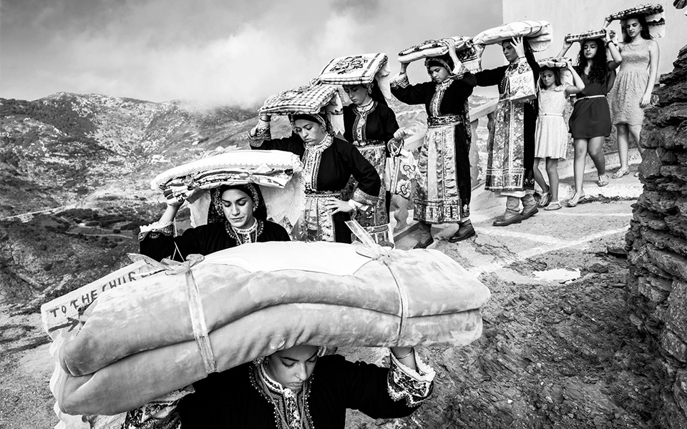
HOW THE CUSTOM OF
DOWRY
AFFECTED WOMEN'S LIVES
THE DOWRY SYSTEM IN GREECE AFFECTED WOMEN'S LIVES IN MANY PRACTICAL WAYS. A WOMAN'S MARRIAGE OFTEN DEPENDED ON HOW MUCH DOWRY HER FAMILY COULD PROVIDE, SO SOME WOMEN MARRIED LATE OR NOT AT ALL. WOMEN HAD LIMITED CHOICES, AND THE DOWRY CREATED DEPENDENCE ON BOTH THEIR HUSBANDS AND THEIR PARENTS. IT ALSO INCREASED SOCIAL INEQUALITY, SINCE RICHER ONES COULD ARRANGE BETTER MARRIAGES, WHILE POORER ONES, FACED DEBT AND PRESSURE. OVERALL, THE DOWRY SHAPED WOMEN'S PERSONAL RELATIONSHIPS AND STRONGLY INFLUENCED THEIR SOCIAL AND ECONOMIC FUTURE
ΗΙΓΓΓΙΘΚΙΘΠ
THE POORER ONES OFTEN WORKED AS MAIDS, OR IN THE HOMES OF RICHER FAMILLIES, DOING THE HARDEST AND MOST TIRING TASKS. SOME BECAME PSYCHOKORES, MEANING GIRLS WHO LIVED IN ANOTHER FAMILY'S HOUSE AND WORKED CONSTANTLY, HOPING THAT THE FAMILY WOULD GIVE THEM A DOWRY OR SOME FINANCIAL HELP. THEIR DAILY LIFE WAS VERY DIFFICULT: THEY FACED EXHAUSTION, STRICT RULES, FREQUENT MISTREAMENT EVEN SOMETIMES SEXUAL ASSAULT WHILE HAVING A CONSTANT FEAR ABOUT THEIR FUTURE, SINCE THERE WAS NO GUARANTEE THAT THE PROMISES MADE TO THEM, WOULD EVER BE KEPT.
ThePhoto by PhotoAuthor is licensed under CCYYSA.

Slide 12
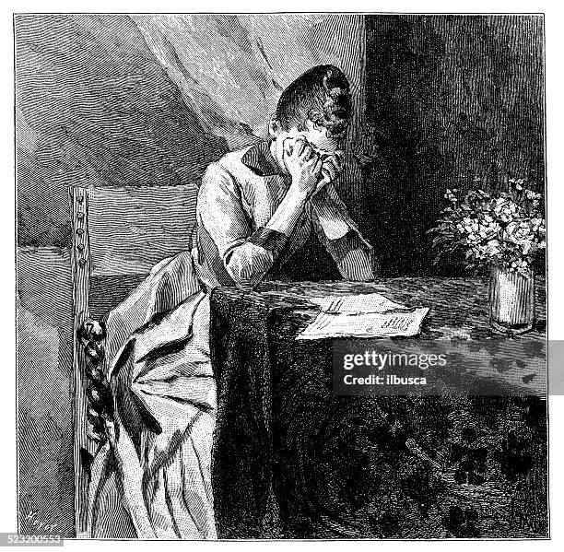
HOW THE CUSTOM OF
DOWRY
HAD A STRONG EMOTIONAL IMPACT ON WOMEN
MANY WOMEN FELT, THAT THEIR VALUE WAS MEASURED IN MONEY AND PROPERTY, WHICH CREATED INSECURITY AND LOW SELF-ESTEEM. THE PRESSURE TO "JUSTIFY" THEIR DOWRY, CAUSED STRESS AND FEAR ABOUT THE FUTURE. WOMEN OFTEN FELT THEY HAD LITTLE CONTROL OVER IMPORTANT LIFE DECISIONS, LEADING TO DISAPPOINTMENT, ANGER, OR A SENSE OF UNFAIRNESS. DEPENDING ON THEIR FAMILIES AND HUSBANDS CREATED FEELINGS OF BEING TRAPPED AND HAVING LIMITED FREEDOM.
ΗΙΓΓΓΙΘΚΙΘΠ
MANY WOMEN ALSO FELT LONELINESS, FRUSTRATION, AND A CONSTANT WORRY THAT THEY WOULD BE JUDGED, OR COMPARED TO OTHER WOMEN. ALL THESE EMOTIONS, DEEPLY AFFECTED THEIR CONFIDENCE AND OVERALL, WELL-BEING.
ThePhoto by PhotoAuthor is licensed under CCYYSA.

Slide 13
HOW THE CUSTOM OF
DOWRY
INSPIRED VARIOUS ARTISTS
ΗΙΓΓΓΙΘΚΙΘΠ
ThePhoto by PhotoAuthor is licensed under CCYYSA.

Slide 14
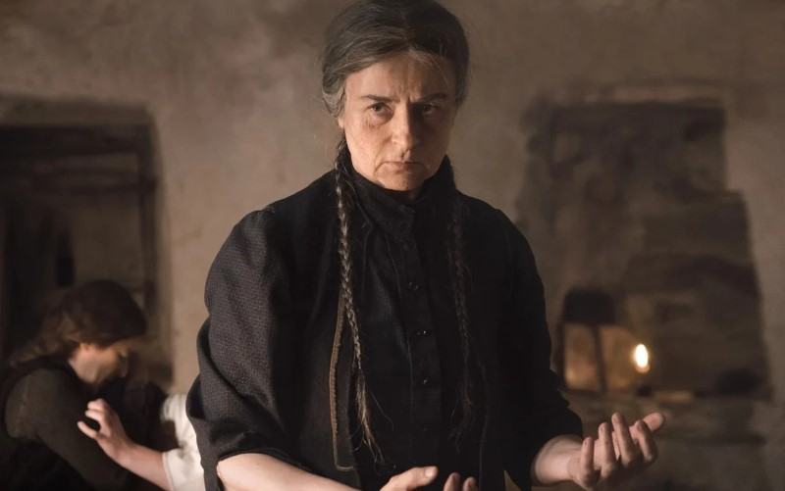
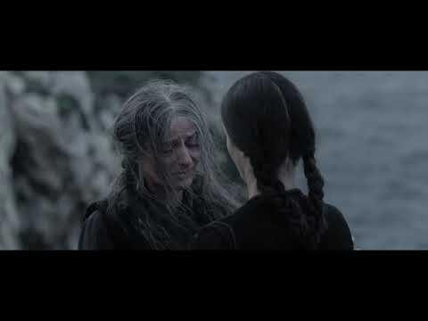
"FONISSA"
By "Alexander Papadiamantis"
THE FILM NAMED "FONISSA" WHICH MEANS " FEMALE MURDERER", IS BASED ON THE WELL-KNOWN STORY BY "ALEXANDROS PAPADIAMANTIS" WHICH TELLS THE STORY OF AN ELDERLY WIDOW WHO, BELIEVED THAT THE BIRTH OF A FEMALE CHILD BRINGS ONLY MISFORTUNE, STRANGLES INFANTS, BECAUSE THEIR FAMILIES HAD TO WORK VERY HARD TO PROVIDE THEM WITH DOWRY IN ORDER TO MARRY THEM OFF. FOR THIS REASON, THE OLD WOMAN IS KILLING ALL OF THE FEMALE NEWBORNE BABIES.
ΗΙΓΓΓΙΘΚΙΘΠ
THE STORY EXPLORES THE WOMAN'S PSYCHOLOGY,HER CRITICIZING THE INSTITUTION OF THE DOWRY AND THE DOWRY CONTRACT, THE OPPRESSION OF WOMEN IN THE PATRIARCHAL SOCIETY OF THE TIME, AND THE SOCIAL CONTRASTS, BETWEEN THE POOR AND THE RICH.
ThePhoto by PhotoAuthor is licensed under CCYYSA.

Slide 15
"FONISSA"
By "Alexander Papadiamantis"
THE FILM NAMED "FONISSA" WHICH MEANS " FEMALE MURDERER", IS BASED ON THE WELL-KNOWN STORY BY "ALEXANDROS PAPADIAMANTIS" WHICH TELLS THE STORY OF AN ELDERLY WIDOW WHO, BELIEVED THAT THE BIRTH OF A FEMALE CHILD BRINGS ONLY MISFORTUNE, STRANGLES INFANTS, BECAUSE THEIR FAMILIES HAD TO WORK VERY HARD TO PROVIDE THEM WITH DOWRY IN ORDER TO MARRY THEM OFF. FOR THIS REASON, THE OLD WOMAN IS KILLING ALL OF THE FEMALE NEWBORNE BABIES.
ΗΙΓΓΓΙΘΚΙΘΠ
THE STORY EXPLORES THE WOMAN'S PSYCHOLOGY,HER CRITICIZING THE INSTITUTION OF THE DOWRY AND THE DOWRY CONTRACT, THE OPPRESSION OF WOMEN IN THE PATRIARCHAL SOCIETY OF THE TIME, AND THE SOCIAL CONTRASTS, BETWEEN THE POOR AND THE RICH.
ThePhoto by PhotoAuthor is licensed under CCYYSA.

Slide 16
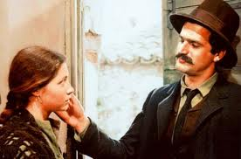
"HONOR AND MONEY"
By "Konstantinos Theotokis"
THE STORY "HONOR AND MONEY", IS ABOUT DOWRY STANDING IN THE WAY OF A YOUNG COUPLE'S LOVE . ANDREAS, AN ARISTOCRAT FACING FINANCIAL DIFFICULTIES, AND RINI, A GIRL OF HUMBLE ORIGIN. THE STORY TAKES PLACE ON AN ISLAND AND REACHES ITS CLIMAX WITH BETRAYAL OF LOVE FOR THE SHAKE OF MONEY. ANDREAS REFUSES TO WORK, AND RINI'S MOTHER EVENTUALLY PAYS THE DOWRY TO HIM TO MARRY HER. HOWEVER, RINI, NOW AWARE OF THE SITUATION, REJECTS THE OFFER AND LEAVES TO LIVE WITH THE CHILD SHE IS CARRYING, LEAVING ANDREAS BEHIND.
ΗΙΓΓΓΙΘΚΙΘΠ
ThePhoto by PhotoAuthor is licensed under CCYYSA.

Slide 17
"HONOR AND MONEY"
By "Konstantinos Theotokis"
THE STORY "HONOR AND MONEY", IS ABOUT DOWRY STANDING IN THE WAY OF A YOUNG COUPLE'S LOVE . ANDREAS, AN ARISTOCRAT FACING FINANCIAL DIFFICULTIES, AND RINI, A GIRL OF HUMBLE ORIGIN. THE STORY TAKES PLACE ON AN ISLAND AND REACHES ITS CLIMAX WITH BETRAYAL OF LOVE FOR THE SHAKE OF MONEY. ANDREAS REFUSES TO WORK, AND RINI'S MOTHER EVENTUALLY PAYS THE DOWRY TO HIM TO MARRY HER. HOWEVER, RINI, NOW AWARE OF THE SITUATION, REJECTS THE OFFER AND LEAVES TO LIVE WITH THE CHILD SHE IS CARRYING, LEAVING ANDREAS BEHIND.
ΗΙΓΓΓΙΘΚΙΘΠ
ThePhoto by PhotoAuthor is licensed under CCYYSA.

Slide 18
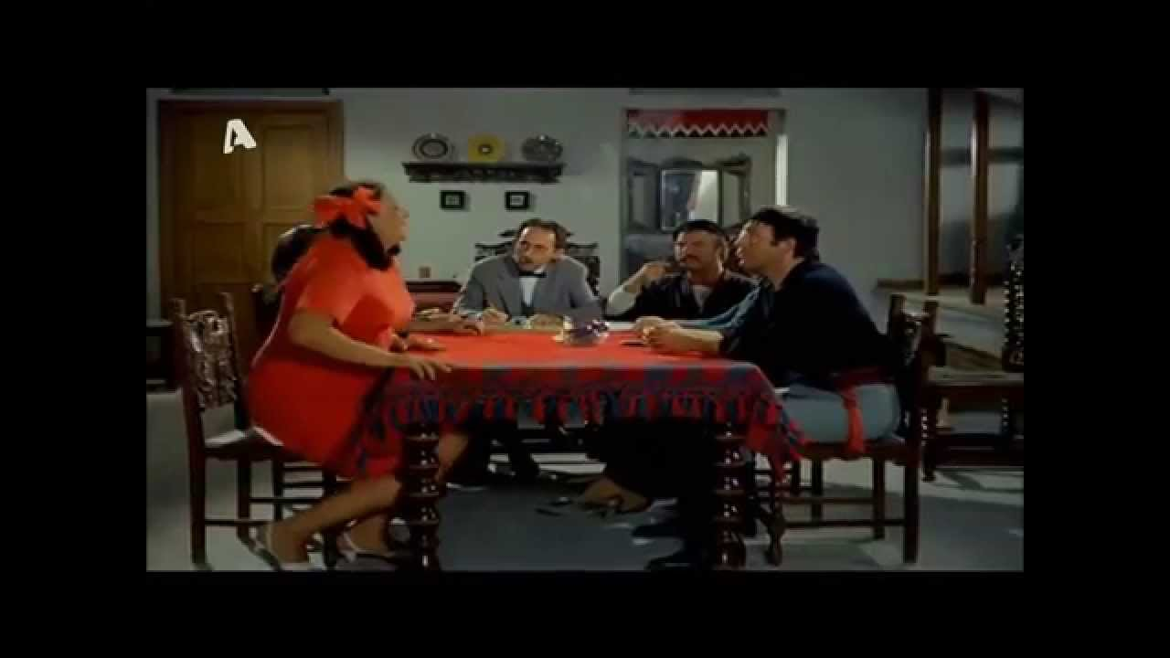
"THE FAIRY AND THE YOUNG MAN"
A CLASSIC GREEK COMEDY FILM FROM 1969. IN THIS SCENE, WE CLEARLY SEE THE PREVAILING PERCEPTION REGARDING DOWRY AND WOMEN'S RIGHTS. THE FILM, PRESENTS A SCENE FROM "THE MATCHMAKING OF LENIO" FROM THE FILM "THE FAIRY AND THE YOUNG MAN" . HUMOROSOUSLY PRESENTING THE OLD CUSTOMS OF MATCHMAKING, WHERE FAMILIES OFTEN DECIDED THE MARRIAGE WITHOUT TAKING INTO ACCOUNT THE WILL OF THE YOUNG PEOPLE. THROUGH EXAGGERATIONS AND FUNNY MOMENTS, THE EXCERPT SHOWS HOW THE SOCIAL PRESSURE OF THE TIME CLASHED WITH PERSONAL CHOICE AND REAL FEELINGS. THUS, THE SCENE HIGHLIGHTS THE DIFFERENCE BETWEEN TRADITIONAL WAYS OF THINKING AND THE YOUNGER GENERATION, WHO WANTED TO MARRY OUT OF LOVE AND NOT BECAUSE THEY "HAD TO". IT ALSO SHOWS, THAT THE WOMEN SITTING AT THE TABLE, DID NOT HAVE THE RIGHT TO SPEAK THEIR MIND OUT LOUD.
ΗΙΓΓΓΙΘΚΙΘΠ
Video Link: URL
ThePhoto by PhotoAuthor is licensed under CCYYSA.

Slide 19
"THE FAIRY AND THE YOUNG MAN"
A CLASSIC GREEK COMEDY FILM FROM 1969. IN THIS SCENE, WE CLEARLY SEE THE PREVAILING PERCEPTION REGARDING DOWRY AND WOMEN'S RIGHTS. THE FILM, PRESENTS A SCENE FROM "THE MATCHMAKING OF LENIO" FROM THE FILM "THE FAIRY AND THE YOUNG MAN" . HUMOROSOUSLY PRESENTING THE OLD CUSTOMS OF MATCHMAKING, WHERE FAMILIES OFTEN DECIDED THE MARRIAGE WITHOUT TAKING INTO ACCOUNT THE WILL OF THE YOUNG PEOPLE. THROUGH EXAGGERATIONS AND FUNNY MOMENTS, THE EXCERPT SHOWS HOW THE SOCIAL PRESSURE OF THE TIME CLASHED WITH PERSONAL CHOICE AND REAL FEELINGS. THUS, THE SCENE HIGHLIGHTS THE DIFFERENCE BETWEEN TRADITIONAL WAYS OF THINKING AND THE YOUNGER GENERATION, WHO WANTED TO MARRY OUT OF LOVE AND NOT BECAUSE THEY "HAD TO". IT ALSO SHOWS, THAT THE WOMEN SITTING AT THE TABLE, DID NOT HAVE THE RIGHT TO SPEAK THEIR MIND OUT LOUD.
ΗΙΓΓΓΙΘΚΙΘΠ
Video Link: URL
ThePhoto by PhotoAuthor is licensed under CCYYSA.

Slide 20
THE CUSTOM OF
DOWRY
"OUR QUASTIONNARY ANALYSIS AND RESEARCH"
ΗΙΓΓΓΙΘΚΙΘΠ
ThePhoto by PhotoAuthor is licensed under CCYYSA.

Slide 21
"Identification and management of gender-based discrimination within our school community: Analysis, Challenges, and Prospects for Equality"
Gender: BOY/GIRL
QUASTIONNAIRY FOR STUDENTS
1.Do you believe that the institution of dowry exists (formally or informally) in modern Greek society?
Yes, definitely /boys:30%- girls :40%
Probably /boys:65%- girls: 60%
No, not at all /boys:5%- girls:0%
ΗΙΓΓΓΙΘΚΙΘΠ
2.Do you consider that the dowry is a form of discrimination?
Against women /boys:35%- girls:75%
Against men /boys:20%-girls:10%
Against both genders /boys:25%-girls:10%
It was/is not a form of discrimination /boys:20%-girls:15%
RL
3.Do you consider that is legitimate for parents, to offer financial support to their children when they get married?
Yes, definitely /boys:50%-girls:50%
Probably /boys:30%-girls:30%
No, not at all /boys:20%-girls:20%
ThePhoto by PhotoAuthor is licensed under CCYYSA.

Slide 22
"Identification and management of gender-based discrimination within our school community: Analysis, Challenges, and Prospects for Equality"
Gender: BOY/GIRL
QUASTIONNAIRY FOR STUDENTS
4.In an ideal society, should there be some form of financial support to young people when they get married?
Yes, definitely /boys:40%-girls:60%
Probably /boys:45%-girls:30%
No, not at all /boys:15%-girls:10%
ΗΙΓΓΓΙΘΚΙΘΠ
5.Do you agree with the legal abolition of the dowry in 1983?
Yes, definitely /boys:25%-girls:50%
Probably /boys:40%-girls:10%
No, not at all /boys:35%-girls:40%
RL
6.Should the dowry be replaced by offering wedding gifts as a custom?
Yes, definitely /boys:40%-girls:45%
Probably /boys:25%-girls:30%
No, not at all /boys:35%-girls:25%
ThePhoto by PhotoAuthor is licensed under CCYYSA.

Slide 23
SOURCES
https://www.mixanitouxronou.gr/tag/prika/
https://hellasjournal.com/2022/01/i-diadromi-tis-prikas-stous-eones-i-epivravefsi-tis-parthenias-ke-i-apozimiosi-tou-gamprou/
https://argolikivivliothiki.gr/2019/02/13/dowry/
https://www.lavyrinthos.gr/?q=node%2F38
https://www.iefimerida.gr/author/newsroom-iefimeridagr
https://www.athensvoice.gr/life/life-in-athens/794277/oi-psuhokores-kai-oi-upiretries-ton-athinon/
ΗΙΓΓΓΙΘΚΙΘΠ
RL
ThePhoto by PhotoAuthor is licensed under CCYYSA.

Slide 24
Project Team
Ms. Despoina Tripolitaki - Our Team Leader
Contributors, Designers & Info gatherers
Elpida Nikaki
Maria Nikiforou
Justinian Lekgegaj
Thomas Rentinopoulos
Stefanos Papadakis
Vasilia Dimitropoulou
Konstantina Andronikidou
ΗΙΓΓΓΙΘΚΙΘΠ
RL
ThePhoto by PhotoAuthor is licensed under CCYYSA.

Slide 25
2ο ΕΠΑΛ ΡΕΘΥΜΝΟΥ
Project Code:
2024-1-el01-ka122-sch-000231856
Thank you for your attention
ΗΙΓΓΓΙΘΚΙΘΠ
RL
« Με την επιχορήγηση της ΕυρωπαΪκής Ένωσης, Ωστόσο, οι απόψεις και οι γνώμεις που διατυπώνονται εκφράζουν αποκλειστικά τις απόψεις των συντάκτων και δεν αντιπροσωπεύονται κατ' ανάγκη τις απόψεις της Ευρωπαϊκής Ένωσης ή του Ιδρύματος Κρατικών Υποτροφιών (ΙΚΥ), Ούτε η Ευρωπαϊκή Ένωση ούτε η χορηγούσα αρχή μπορούν να θεωρηθούν υπεύθηνες για αυτές.»
ThePhoto by PhotoAuthor is licensed under CCYYSA.

